Slide 1
Module 7 - Data storage and file handling
7: Data Storage and File Handling
8: Functions
9: Advanced Collections

Slide 2
By the end of this chapter, learners will be able to:
Write code that reads and writes data sequentially and randomly to and from text and binary files
Understand how to read and write to standard streams
Preserve complex objects using Pickles and Shelves
Use compression techniques to reduce file footprints
Notes:
Python has input/output features which are very easy to use, with syntax reminiscent of C and PHP.

Slide 3
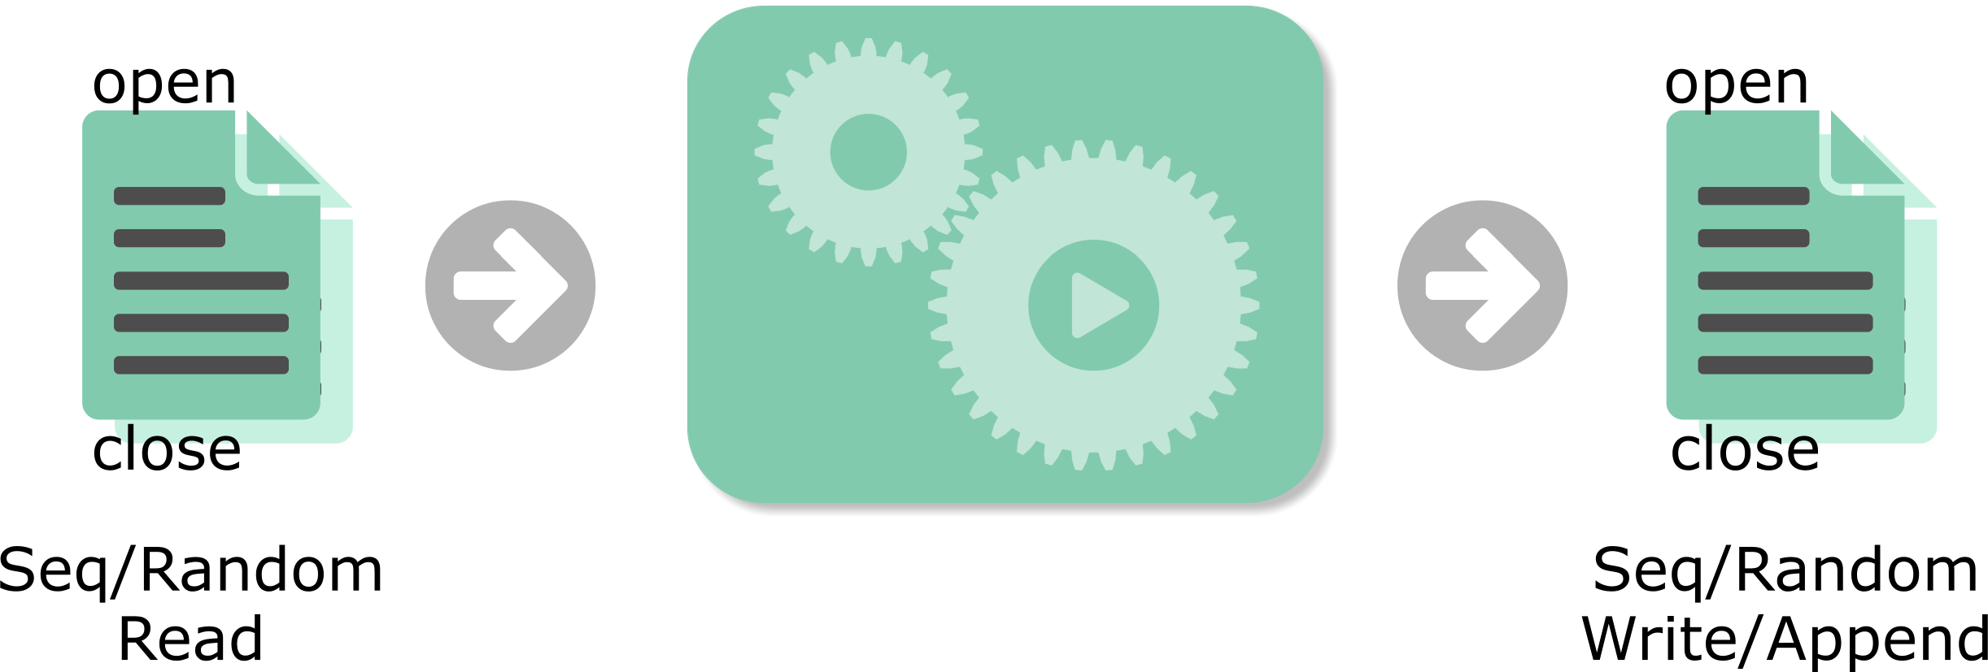
Interacting with files
Useful programs often read and write to files.
How do we open, close, and identify files?
How do we want to interact – read, write, or append?
Sequential or random reading?
Notes:
One of the most common tasks for a program is to interact with file system objects such as files. A file system can accumulate a large number of files with different formats and different data within. There are many Python modules to deal with specific types of files such as html, xml, json and csv.
Python has several built-in functions and objects to open, close, read and write strings and bytes to files. But there are several important considerations we to make. How many files can we open at any given time and how do we identify them? How do we open files for reading, writing and appending or some combination of these. Are we restricted to reading and writing lines sequentially or can we seek faster through a file to a specific position? And do we have to close files explicitly or can they be closed automatically? Can we just write data or can we preserve Python structures like lists and dictionaries to files?
These are some of the considerations that we will examine in this chapter.

Slide 4
New file objects
File objects are created with the open function:
Valid open modes :
File will be closed on exit or better still closed explicitly:
fh_object = open(filename, mode='rt', buffering=-1, encoding=None, errors=None, newline=None, closefd=True, opener=None)
Mode | Meaning
'r' | open existing file for read (default)
'w' | open file for write, create or overwrite existing file
'a' | open file for append, create if does not exist
'x' | create file and open for write, fails if file exists (3.3)
'r+' | open existing file for read/write
'w+' | create & truncate file for read/write
'a+' | create & append file for read/write
t=text, b=binary mode
buffering=1 (text)
buffering=4096|8192 (binary)
Info for other parameters:
>>> help(open)
fh_object.close()
Notes:
Files in Python are accessed through file objects, created using the built-in open() function. A 'b' should be appended to the mode for binary files, while 't' (for text files) is optional since it is the default.
Files are automatically closed and flushed when the program exits or when the file object is destroyed (for example, when it goes out of scope). However, it is good programming practice to close files explicitly by calling the close() method, or more commonly, by using a with statement (context manager) to ensure proper cleanup.
The mode 'x', introduced in Python 3.3, is used to exclusively create and open a new file. If the file already exists, an exception is raised: FileExistsError: [Errno 17] File exists.
The buffering argument controls how data is buffered:
0 Unbuffered (binary mode only)
1 Line-buffered (usually for text files)
>1 Use a buffer of the given size
-1 Use a system-appropriate buffer size (Default)
Other optional parameters include encoding, errors, newline, and closefd, though these are rarely needed. From Python 3.3, the opener parameter was added, allowing a custom file-opening function to be supplied.

Slide 5
Reading files into Python
Create a file object with open():
Read n characters (in text mode):
This may return fewer characters near end-of-file.
If n is not specified, the entire file is read.
Read a line
The line terminator "\n" is included.
Returns an empty string (False) at end-of-file.
infile = open('filename', 'rt')
buffer = infile.read(42)
line = infile.readline()
Notes:
Once a file object has been created, it can be read using one of several available methods.
The read() method reads data starting from the current file position. You can optionally specify the number of characters (in text mode) or bytes (in binary mode) to read.
Related methods include:
seek(offset) Moves the current file position to the specified location.
tell() Returns the current position within the file.
To read a single line of text (a record terminated by a newline character), use readline(). This is one of the most common ways to process text files in Python. Note that the newline character (\n) is included in the returned string; it can be removed using slicing ([:-1]) or the rstrip('\n') method.

Slide 6

Reading tricks
Reading the whole file into a variable
Be careful of the file size.
Reading a file sequentially in a loop
Inefficient:
Use the file object iterator:
lines = open('brian.txt').read()
llines = open('brian.txt').read().splitlines()
linelist = open('brian.txt').readlines()
for line in open('lines.txt').readlines():
print(line, end="")
for line in open('lines.txt'):
print(line, end="")
Notes:
In the first three examples:
The first (lines) reads the entire file into a single string.
The second (llines) also reads the whole file, then splits it into a list of lines using splitlines().
The third (linelist) similarly produces a list, but the newline characters are retained in each element.
When reading a file line by line (a common requirement), it is generally more efficient to use the file iterator directly in a for loop. Using readlines() in a loop first loads the entire file into memory as a temporary list, then iterates through that list - which can be inefficient for large files.
Note the use of the end parameter in the print() statements. This prevents Python from printing an extra newline, since each record already ends with one.
Finally, avoid calling seek() (random access) inside a for loop that iterates over the file - it interferes with the file iterator and may cause an infinite loop.

Slide 7
Managing file handles using try/except/else/finally
Under very rare circumstances, a file could be left open
An error could cause an unhandled exception
Leading to lost data or memory leaks
Use Exception Handler – try/except/finally
Ensures file handle is closed
Can catch named exceptions during opening
Else block only executes if try block succeeds
Finally block always executes
try:
fh_out = open('spam.txt', 'wt')
except FileNotFoundError as err:
print('Blooming Vikings!')
else:
try:
fh_out.write('Spam, spam, spam!')
finally:
# Always close file handle afer use
fh_out.close()
First try block protects the open() call
Nested try block protects the write, and finally block ensures file handle is always closed
Notes:
When working with external resources such as files, it’s important to release them properly once you’re finished reading or writing. Failing to do so can cause your program to retain resources indefinitely, leading to memory leaks or loss of unwritten data.
Most programs include a setup and teardown phase - with the teardown phase handling clean-up tasks such as closing files, releasing locks, or shutting down network and database connections.
When writing to files, data is often buffered in memory, and if the program exits unexpectedly, that data may be lost unless the file is properly closed. Calling the file object’s close() method ensures that any buffered data is flushed to disk and that the resource is released.
To guard against exceptions that occur before a resource is closed, Python offers two main strategies:
Using a try/finally construct, or
Using a context manager with the with statement.
In the first approach, the open() function is wrapped in a try/except/else block. Any errors raised in the try block can be handled in except, and the finally block, which always runs safely closes the file.

Slide 8
Managing file handles using Context Resource Manager
Under very rare circumstances, a file could be left open.
An error could cause an unhandled exception.
Some python classes are context managers.
io is the most common - file objects are context objects.
Uses the with keyword.
Ensures files are closed on error.
This usually happens anyway with a for loop.
This is rarely needed - but safer!
with open('spam.txt', 'rt') as fh_in:
for line in fh_in:
print(line, end='')
fh_in is a file and context object
and only exists for this block
Notes:
PEP 343 introduced a cleaner and safer way to manage external resources, such as file handles, using the with statement and the Context Manager Protocol. This approach replaces many uses of try/finally, producing more elegant, efficient, and reliable code.
The with statement creates a runtime context managed by an object that defines __enter__() and __exit__() methods, which automatically handle setup and cleanup.
A common example is the file object, used as follows:
with expression [as variable]:
BLOCK
The expression returns a context object whose __enter__() method is called at the start of the block, and __exit__() when the block ends - even if an exception occurs. If the as keyword is used, the variable is bound to the object returned by __enter__().
This mechanism provides automatic resource management and avoids problems with destructors or unclosed files. You don’t need to retrofit existing code, but it’s strongly recommended for new development.

Slide 9
Writing to files from Python
Open a file handle with open:
Specifying write or append.
Write a string.
Append "\n" to make it a line.
Returns the number of chars (text) or bytes (binary) written.
Write strings from a list.
Append "\n" to each element to make lines.
output = open('myfile’, mode='w')
append = open('logfile’, mode='a')
num = output.write("Hello\n")
output.writelines(list)
Notes:
Just as there are several ways to read from a file, there are also multiple ways to write to one.
The write() method writes characters (or bytes, in binary mode) to the current file position - but remember to include a newline character (\n) yourself when writing text files.
The write() method returns the number of characters or bytes written, depending on how the file was opened. This behaviour was added in later versions of Python; older versions did not return a value.
To write multiple records from a list, use the writelines() method. Despite its name, it does not automatically add newline terminators - each line in the data must already include one.

Slide 10
Binary mode
By default, open modes are text:
Reading and writing uses native Python strings.
Remember that Python 3 strings are multi-byte (Unicode).
Open a file as binary using 'b' with the mode:
Reading and writing uses bytes objects, not Python strings.
Convert to a Python string using bytes.decode()
Can also write a bytes object.
Convert from a Python string using string.encode()
for line in open('lines.txt', 'rb'):
print(line.decode(), end="")
fh_out = open('out.dat','wb’)
num_bytes = fo.write(b'Single bytes string’)
my_string = "Native string as a line\r\n"
num_bytes = fh_out.write(my_string.encode())
Notes:
Many programming languages, such as C and Perl, distinguish between text and binary file modes on Windows, because the Windows operating system handles these formats differently.
On UNIX-like systems, there is no such distinction - files are simply sequences of bytes.
In Python 3 (as in Java and .NET), strings are Unicode, meaning they represent multi-byte characters by default. When a file is opened in text mode (the default), Python automatically handles the conversion between text (Unicode strings) and the underlying byte data.
Writing a Python string will appear as ordinary text in the file, provided the characters are within a single-byte character set such as ISO Latin-1.
Opening a file in binary mode ('b') forces single-byte operations using bytes objects.
Fortunately, converting between strings and bytes is straightforward, and most string methods are also available for byte objects. Text mode also manages platform-specific line endings automatically (\n on UNIX, \r\n on Windows). In binary mode, however, no such conversion takes place - if you need line endings, you must include them explicitly.

Slide 11
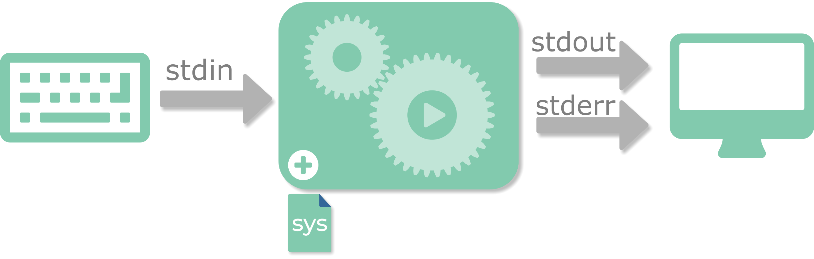
Standard streams
The sys module exposes stdin, stdout, stderr as open file objects.
No need to open/close these standard IO streams.
Import sys for visibility of names stdin, stdout and stderr.
Notes:
Like Unix and Linux, Windows provides three standard I/O channels for handling keyboard input, program output, and error messages. These are special file-like interfaces that allow a process to interact with the user and display information on the screen. The three channels are traditionally numbered 0, 1, and 2, and are named stdin, stdout, and stderr respectively.
Python supports these standard streams, allowing both built-in and library functions to read input and produce output or error messages without explicitly opening or closing files. To access them by name, you need to import the sys module.
By default, the built-in input() function reads from stdin, and the print() function writes to stdout.

Slide 12
Standard streams
The sys module exposes stdin, stdout, stderr as open file objects.
Simple keyboard (stdin) input.
The "\n" is stripped from rhs.
Remove additional whitespace entered using rstrip() method.
import sys
sys.stdout.write("Please enter a value: ")
sys.stdout.flush()
reply = sys.stdin.readline()
print("<", reply, "> was input")
Please enter a value: one
< one
> was input
reply = input("Please enter a value: ").rstrip()
print("<", reply, "> was input")
Please enter a value: two
< two > was input
Notes:
The three standard I/O streams, stdin, stdout, and stderr, can be accessed directly through the sys module. Each is a file-like object and can be used just like any other file handle.
The input() function reads from stdin, which is typically connected to the keyboard but can be redirected from another source. If the readline module is imported first, input() gains line-editing and command-history capabilities. (In Python 2, this function was called raw_input().)
On Windows cmd.exe, line endings are represented by "\r\n". A bug in Python 3.2.0 caused the newline character to be stripped while leaving "\r" behind. Although this was fixed in Python 3.2.1, using str.rstrip() remains a useful safeguard, especially if users might include trailing spaces.
By default, standard streams operate in text mode, but they can be used in binary mode by launching Python with the -u option, for example:
python -u myprog.py

Slide 13
More tricks
print normally writes to stdout, but can write to other file handles:
File writing is normally buffered:
To flush the buffer:
Emulating the Linux tail -f command in Python:
fh_out = open('myfile', 'wt')
print("Hello", file=fh_out)
print("Oops, we had an error", file=sys.stderr)
Text written to stderr will be displayed in red on python console
fh_out.flush()
import time
while True:
line = fh_out.readline()
if not line:
time.sleep(1)
fh_out.seek(fh_out.tell())
else:
print(line, end="")
Assumes the file is open for read
Set the file position to EOF
Notes:
In Python 3, the print() function can write directly to a file using the file= parameter. In earlier versions of Python, output redirection used a different syntax, for example:
print >> output, "Hello" # Python 2
Buffering can be disabled either by running Python with the -u command-line option or by setting the PYTHONUNBUFFERED environment variable to any non-empty value.
The final example involves the UNIX command tail -f, which continuously displays new lines as they are appended to a file. It works by reading to the end of the file, pausing briefly (typically one second), and then checking for new data. If new lines have been added, they are displayed; otherwise, the program waits and repeats. One unusual aspect of this example is the use of seek() to reset the current file position. When the end of the file is reached, the file position becomes invalid, so the line
fh_out.seek(fh_out.tell())
moves the pointer back to the same physical position, allowing the program to continue monitoring the file for new content.

Slide 14
Random access
Access directly at a position, rather than sequentially:
Of limited use with text files - all lines must be the same length.
Get the current position with the tell() method.
Set the position with seek(offset[,whence])
Binary access may be required for the correct offsets.
Offsets are in bytes, not characters!
fh_in = open('country.txt', 'rb')
index={}
while True:
line = fh_in.readline()
if not line: break
fields = line.decode().split(',')
index[fields[0]] = fh_in.tell() - len(line)
key = input('Enter a country:')
fh_in.seek(index[key])
print(fh_in.readline().decode(), end="")
Binary access
Construct an index keyed on the first field
Notes:
Most file I/O operations, especially with text files, are sequential. Accessing a specific record this way can be inefficient, particularly if repeated. A faster alternative is random (positional) access, where the program seeks directly to a known location in the file. To enable this, an index of record positions can be built, for example, using a dictionary that can later be saved with pickle.
Files should be opened in binary mode, particularly on Windows, where text mode automatically handles carriage returns ('\r') and can cause byte offsets to be misaligned. Binary mode ensures that data is read and written as byte objects, not strings.
A while loop is preferred over a for loop when building an index, because the file iterator may read ahead into an internal buffer, making tell() unreliable. Once record positions are known, the seek() method can be used to move to a given offset and perform reads or writes.
Offsets are measured relative to: the start of the file (whence=0), the current position (whence=1), or the end of the file (whence=2), and most systems allow seeking beyond the end-of-file.

Slide 15
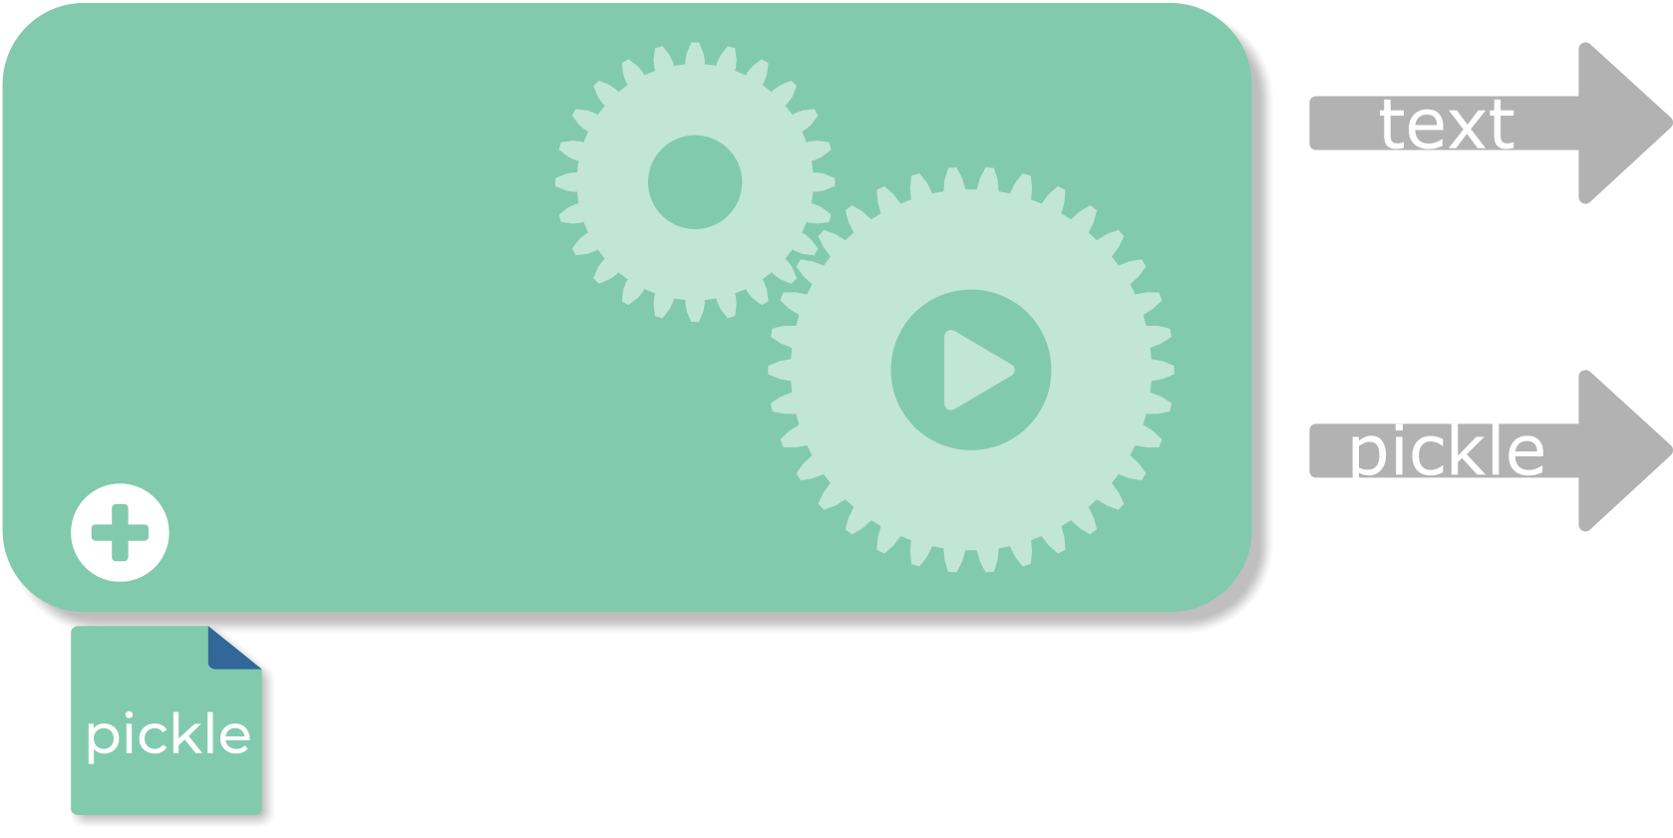
Python pickle persistence
Pickling converts Python objects into a stream of bytes:
Which can be written to a file or across a network.
It means we can save data structures as well as data.
.txt
'Lancelot says Grail and Blue'
'Robin says Grail and Don’t Know'
'Galahad says Grail and Blue'
'Arthur says Grail and African'
quest = {'Lancelot: ['Grail, 'Blue'],
'Robin': ['Grail', 'Don’t Know'],
'Galahad': ['Grail', 'Blue'],
'Arthur': ['Grail', 'African']
}
.p
{'lancelot:['Grail, 'Blue'],
'Robin': ['Grail', 'Don’t Know'],
'Galahad': ['Grail', 'Blue'],
'Arthur': ['Grail', 'African']
}
Notes:
We have already seen how to read, write, and append text or binary data to a file. However, the original Python object structure in memory is lost when doing so, making it difficult to reconstruct later. Think of it like trying to restore an empty tin can after it has been crushed — the contents may be saved, but the shape is gone.
Pickling is the process of converting a complete Python object structure into a byte stream, a process known as serialisation, while preserving both its data and structure. Unpickling is the reverse operation, reconstructing the original object from the stored byte stream. This is similar in concept to JSON in Java or JavaScript, but the pickle module supports serialisation in both text and binary formats.
Today, the pickle protocol is often used to transmit data and commands between processes, either locally or across a network, rather than just for saving to disk. For very large datasets, such as NumPy or Pandas dataframes, you may want to use specialised third-party tools like Dask, PyArrow, or IPyParallel, which provide more efficient serialisation methods.

Slide 16
Python pickle persistence
Pickling converts Python objects into a stream of bytes:
And the code to preserve your Python object is simple.
The file must be opened in binary mode.
Without pickle, how would you preserve complex data structures?
import pickle
caps = {'Australia':'Canberra', 'Eire':'Dublin',
'UK':'London', 'US':'Washington'}
outp = open('capitals.p', 'wb')
pickle.dump(caps, outp)
outp.close()
Using 'b' to indicate binary
Preserve caps object to filehandle outp
import pickle
inp = open('capitals.p', 'rb')
caps = pickle.load(inp)
inp.close()
Load object from filehandle
Set the file position to EOF
Notes:
Pickling is Python’s way of storing its own object types in a file for later use. Always open the file in binary mode when pickling or unpickling data.
Objects that can be pickled include:
None, True, and False
Integers, floating-point numbers, and complex numbers
Strings, bytes, and bytearrays
Tuples, lists, sets, and dictionaries (provided they contain only pickleable objects)
Classes defined at the top level of a module
Although the Python documentation notes that functions can also be pickled, this can be misleading - only the function names are stored, not their actual code. Code itself cannot be easily pickled; that’s what modules are for. In fact, a compiled module (.pyc file) is conceptually similar to a pickle. Python’s internal serialization mechanism, exposed through the marshal module, operates at a lower level than pickle and provides fewer features.

Slide 17
Pickle protocols
How would you like your data pickled?
Currently 5 different protocols to choose from, pickle.protocol=n
The pickle module has protocol attributes.
HIGHEST_PROTOCOL and DEFAULT_PROTOCOL
None of these protocols are secure.
Protocol | Meaning
0 | ASCII, backwards compatible with earlier versions of Python
1 | Binary format, also backwards compatible
2 | Added in Python 2.3. Efficient pickling of classes
3 | Added in Python 3.0. Not backward compatible
4 | Added in Python 3.4. Very large objects and more kinds of objects (default)
5 | Added in Python 3.8 Support for out-of-band data
import pickle
outp = open('capitals.p', 'wb')
pickle.dump(caps, outp, pickle.DEFAULT_PROTOCOL)
outp.close()
Preferred protocol
Notes:
Pickle files can be written in several formats. When in doubt, use the default format, which is automatically selected based on your Python version.
If you choose the ASCII format, you don’t need to open the file in binary mode, but be consistent and use the same mode for both reading and writing. ASCII pickles are easier to debug, while binary format is preferred for compatibility with older Python programs. In most cases, sticking with the default is the safest and most efficient option.
Pickle Protocol Versions:
Protocol 5 (Python 3.8+): Introduced support for out-of-band data buffers, allowing applications to transmit metadata across separate communication channels (e.g., paired sockets); also improves performance for in-band data.
Protocol 4 (Python 3.4+): Added support for very large and complex objects (e.g., data frames) and improved efficiency. Note that it is not backward compatible with earlier protocols.
Protocol 0–2 (Python 2): Early protocols used in Python 2.x. Compatibility issues arose when creating pickles in Python 3.0 for use in Python 2, which were resolved in Python 3.1. However, protocols 0–2 cannot be exchanged between Python 3.0 and 3.1.
For cross-version compatibility, use protocol 3 when sharing data between Python 3, and upgrade to at least Python 3.1 to exchange data with Python 2.

Slide 18
Build some shelves
We often wish to dump keyed structures.
A shelve is a keyed pickle dumped to a database:
Looks just like an ordinary dictionary.
Uses a simple bundled database system, usually dbm.
You only need methods: open(), sync(), close()
import shelve
db = shelve.open('capitals')
db['UK'] = 'London'
...
db.close()
No mode or file suffix required
Same syntax as standard dict
db = shelve.open('capitals')
print(db['UK'])
db.close()
close() does a sync() like a commit
Notes:
The shelve module is a convenient option when using pickling on a larger scale. It stores pickled Python objects in a database file (typically using dbm, depending on the platform) and allows access via string keys. However, you should not assume that the underlying database is portable between systems or compatible with non-shelve tools.
When a shelve database is opened, you can specify different pickle protocols if required. The opened database behaves just like a standard dictionary, supporting both reading and writing of objects.
Be aware that you should not allow multiple programs or threads to access the same shelve file simultaneously. Most operating systems prevent this through file locking, but doing so can still cause errors or data corruption.

Slide 19

Compression
The standard library includes several modules to compress files.
One popular module is gzip which provides its own open() function.
Then call the usual methods on the file handle.
Often used with pickles.
import pickle
import gzip
fh_out = gzip.open('capitals.pgz', 'wb')
pickle.dump(caps, fh_out)
fh_out.close()
import pickle
import gzip
fh_in = gzip.open('capitals.pgz', 'rb')
caps = pickle.load(fh_in)
fh_in.close()
Notes:
For small datasets, compression may not reduce file size - in fact, the resulting file can sometimes be slightly larger.
When working with ZIP files, always open them in binary mode ('rb' or 'wb'), since they handle byte streams rather than text. It’s also good practice to use a filename suffix such as .gz (or .tar, .bz2, etc.) to clearly indicate that the file is compressed.
Finally, don’t confuse this with Python’s built-in zip() function - it’s unrelated. The zip() function combines multiple collections element by element, not file contents.

Slide 20
Other compression modules
Compression/decompression Modules
All modules are in the Python Std Library
Supports compression/decompression in memory or to/from files
Example – Reading a Tar Archive
How to open/close and inspect a .tar/.tgz
Uses tarfile.is_tarfile() to validate file
Iterates through members using getmembers()
Module | Comment
zlib | GNU zlib compression API
bz2 | bzip2 compression
zipfile | Zip archive access (pkzip compatible)
tarfile | TapeARchive (tar) access
shutil | High level archiving operations
import tarfile
import time
filename = 'qapyth3_linux.tgz'
if tarfile.is_tarfile(filename):
tfo = tarfile.open(filename, 'r')
for mdata in tfo.getmembers():
tm = time.localtime(mdata.mtime)
fm_time = time.strftime("%d/%m/%Y %X", tm)
print(f"{mdata.name:<12} {fm_time}") tfo.close()
Last modification time of file formatted to
day/month/year hh:mm:ss
Notes:
The zlib module provides checksum functions such as adler32 and crc32, which are useful for verifying data integrity. However, these checksums are not cryptographically secure.
The bz2 module offers a file-like class, bz2.BZ2File, which can be used much like Python’s built-in open() function for reading and writing compressed data.
The tarfile module supports standard archive operations. Its getmembers() method retrieves metadata for all files in an archive - not just their names. The example shown was run on Windows using a .tar.gz file originally created on Linux.
For a simpler, high-level interface, the shutil module provides generic file and archiving utilities, making it a convenient choice for common compression and extraction tasks.

Slide 21
Review Questions
When reading a file using the file object, what method is best for reading the entire file into a single string?
read()
readlines()
readline()
readall()
Which method is used to set the position of a file pointer?
tell()
seek()
ftell()
fseek()
Notes:
Answers on next page.

Slide 22
Review Questions
What is the main purpose of pickling in Python?
To convert a Python object into a JSON string for web communication
To convert a Python object into a byte stream so it can be saved to a file or sent over a network
To compress a Python file to reduce its size
To encrypt Python data for secure storage
What statement about the shelve module is true?
It only supports plain text data
It stores objects in memory, not on disk
It allows objects to be stored in a file using a key, like a dictionary
It replaces the pickle module entirely
Notes:
Correct answers:
When reading a file using the file object, what method is best for reading the entire file into a single string?
a. read()
Which method is used to set the position of a file pointer?
b. seek()
What is the main purpose of pickling in Python?
To convert a Python object into a byte stream so it can be saved to a file or sent over a network
What statement about the shelve module is true?
It allows objects to be stored in a file using a key, like a dictionary

Slide 23
Summary
Creating a file object:
Use the open() function to create a file object
Reading from a file:
Use read(), readline(), or readlines() methods
Or iterate directly over the file object in a for loop
Writing to a file:
Use write() or writelines() methods
The print() function can also write to files
Always close the file when finished or use a with statement
Additional notes:
Many other file-handling methods are available.
Pickling preserves Python objects to a file.
Shelve can store multiple pickled objects using key access.
Compression reduces file size and saves disk space.

Slide 24
Database interface overview
Available for most popular databases:
Database drivers are expected to conform to a standard.
Import the required database driver, then call standard methods.
Most drivers include extensions.
Two main objects:
Connection object.
Connect to the database.
Create the cursor object.
Transaction management.
Cursor object.
Execute queries on this.
Python is shipped with SQLite.
Notes:
Python provides database drivers for most popular relational database systems, and many are bundled with standard or third-party distributions. These drivers adhere to a common interface defined by the Python Database API Specification v2.0 (DB-API 2.0).
To interact with a database:
Establish a connection using a connection object.
Use this connection to create a cursor object, which handles queries and transaction control (commit and rollback).
The cursor is the primary tool for executing SQL statements and getting results.
Some Common Cursor Methods
arraysize Number of rows fetched by fetchmany()
close() Close the cursor
description Metadata about the result set or table
execute() Execute a single SQL statement (supports placeholders)
fetchall() Retrieve all remaining rows
fetchone() Retrieve the next
rowrowcount Number of rows affected by the last operation
Python is shipped with SQLite, a lightweight, single-file relational database that requires no server setup and is ideal for small to medium-sized applications.

Slide 25
Example - SQLite from Python
Use the sqlite3 module.
Bundled with the Python release.
Example using cursor(), execute(), fetchall() and close() methods:
import sqlite3
db = sqlite3.connect('whisky')
cur = db.cursor()
cur.execute('SELECT BRANDS.BNAME, REGION.RNAME \
FROM BRANDS,REGION \
WHERE REGION.REGION_ID = BRANDS.REGION_ID \
ORDER BY BRANDS.BNAME;')
for row in cur.fetchall():
print("{0[0]:<30s} {0[1]:<30s}".format(row))
db.close()
Notes:
This example demonstrates how to use Python’s sqlite3 module to connect to a relational database and execute a simple SQL query. The connect() function establishes a connection to a database file named whisky - if the file does not already exist, SQLite automatically creates it. From this connection, a cursor object is obtained using db.cursor(). The cursor is the main interface for sending SQL commands and retrieving results.
The execute() method runs an SQL SELECT statement that retrieves brand names and their corresponding regions from two tables, BRANDS and REGION. The WHERE clause ensures that the tables are joined using a common key (REGION_ID), while the ORDER BY clause sorts the results alphabetically by brand name. Once the query executes, the fetchall() method retrieves all matching rows as a list of tuples. The for loop iterates through each row, and the print() statement uses formatted string output to neatly display the brand and region names in two left-aligned columns, each 30 characters wide.
Finally, the db.close() call closes the database connection, ensuring that all resources are released properly. In modern Python code, it’s often recommended to use a context manager (with sqlite3.connect('whisky') as db:) to handle connection closure automatically, even if an error occurs.

Slide 26
Binary files - struct.pack/unpack
Binary file formats don't map to Python variable types.
Unless they were written using Python (like pickle).
Typically, they might be written using C/C++, or similar.
Convert to/from primitive types using pack and unpack.
import struct
fIn = open("bindata", "rb")
data = fIn.read(1024);
fIn.close()
clean = struct.unpack("iid80s", data)
print(clean)
txt = clean[3].decode().rstrip('\x00')
print(txt)
typedef struct {
int a;
int b;
double c;
char name[80];
} data;
(37, 42, 3.142, b'Hollow World!\x00\x00\x00\x00\x00...')
Hollow World!
Notes:
The first challenge when reading binary data is determining its format. Unless the data was originally written by Python (or via the Python API in another language such as C), it won’t map directly to Python’s built-in types - a common issue in all high-level languages.
The example shows a simple C struct written to a file. It contains two integers (int), a double-precision value (double), and an array of 80 characters (a C-style string ending with a null byte).
To interpret this in Python, the struct.unpack() function is used with a format string, here "iid80s", which specifies two integers, one double, and an 80-character string. Because C strings are single-byte, the resulting Python bytes object is converted to text using .decode().
Note: Be careful of padding bytes added by C compilers for alignment, as these vary between 32- and 64-bit systems and can be changed with #pragma pack. Also watch for endianness differences, which are detailed in the Python struct module documentation.

